Slide 1
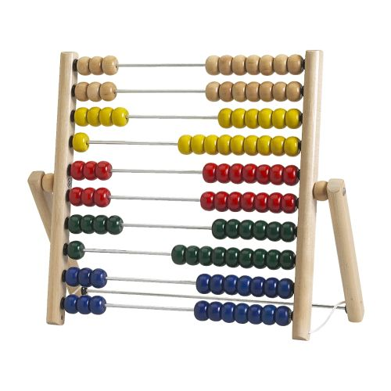
Balanced Approach 2013-14 Nova Scotia Budget Submission

Slide 2
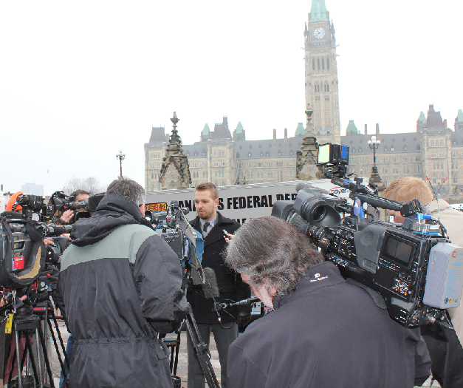
We are:
Non-profit, Non-partisan
We Stand For:
Lower Taxes
Less Waste
More Accountability
What We Do:
Direct advocacy with politicians
Educate/mobilize supporters

Slide 3
At a Glance…
Nova Scotia suffers from tax and spend problem – money is routinely thrown at issues while politicians cross their fingers and hope it delivers results.
This has resulted in:
Poor service results
High taxes
High debt
Underperforming economy

Slide 4
The Problem – Govt Taxes Too Much
Taxpayers pay 34% more in total income taxes & 50% more in HST (inflation adjusted) since 2003

Slide 5
The Problem – Govt Spends Too Much
Real (inflation adjusted) spending up 65% since 2003.

Slide 6
Five Proposals For Change…
20% Pay cut to members of cabinet if unable to balance the budget
50/50 Tax reduction strategy
End Taxpayer Gifts to Corporations
5% Reduction in size and costs of government
New Taxpayer Protection Act

Slide 7
1) Cut Cabinet Minister Salary By 20% if Budget is Not Balanced
Bring in new Taxpayer Accountability Act that would force politicians to be held responsible if they spend more than government takes in
Principal: like in private business, if you miss your targets then those in charge should be held responsible
Cabinet Ministers: $9,600 cut
Premier: $22,116
Note: Salaries based on for Jan 1st 2012

Slide 8
2)50/50 Tax Plan
50 cents on every dollar of new revenue will be put towards lowering taxes
These reductions would be on top of legislated HST reduction.
Tax Reduction Should be Dedicated to:
Ending bracket creep
Raise level of personal exemption
Removal of income tax brackets to move to a “flatter” tax
Reduction of income tax rates
Cut general business taxes

Slide 9
3) End Give Aways to Companies
Eliminate the Nova Scotia Jobs Fund
Cut Nova Scotia Business Inc, roll its duties in to the Department of Economic Development
Dedicate all savings through these measures to reducing small business, corporate and personal income taxes.

Slide 10
4) Reduce Size of Government
Size of government growing 7.6% despite Nova Scotia’s population growing just 1.4% since ‘08
CTF proposes rolling back number of FTEs to 2008 levels.
Total savings: $53million (estimate)

Slide 11
Number of full time equivalents as represented in the budget estimates 2008 are actuals and 2013 are estimates
4) Reduce Size of Government
10,649
9,892
2007-08
2012-13

Slide 12
5) Introduce a Taxpayer Protection Act
Any government wishing to increase taxes will be forced to either get a mandate to do so from an election or a referendum.
Allows taxpayers a say in whether or not government can hike taxes
Prevents politicians from promising in a campaign only to hike them once they are elected

Slide 13
Conclusion…
CTF plans are designed to change the incentives in government
Reduce the overall size of government; and
Allow citizens to have a real say in the decisions their politicians make that directly affects them

